Slide 1



Machine Learning
Internal
Sundeep Gullapudi, Month 10, 2017

Slide 2
Agenda
Tools and Tweaks
What is ML ?
Types
Basic Math's
Regression
Linear regression using gradient descent
Polynomial Regression
Basic Intuition of training, validation, test sets
Bias Vs. Variance
Linear Regression Demo + Hands On
Scikit-Learn
sklearn Demo + Hands On
Machine Learning Vs. Deep Learning
Queries ?

Slide 3

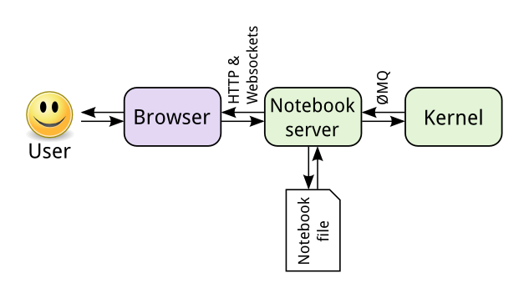
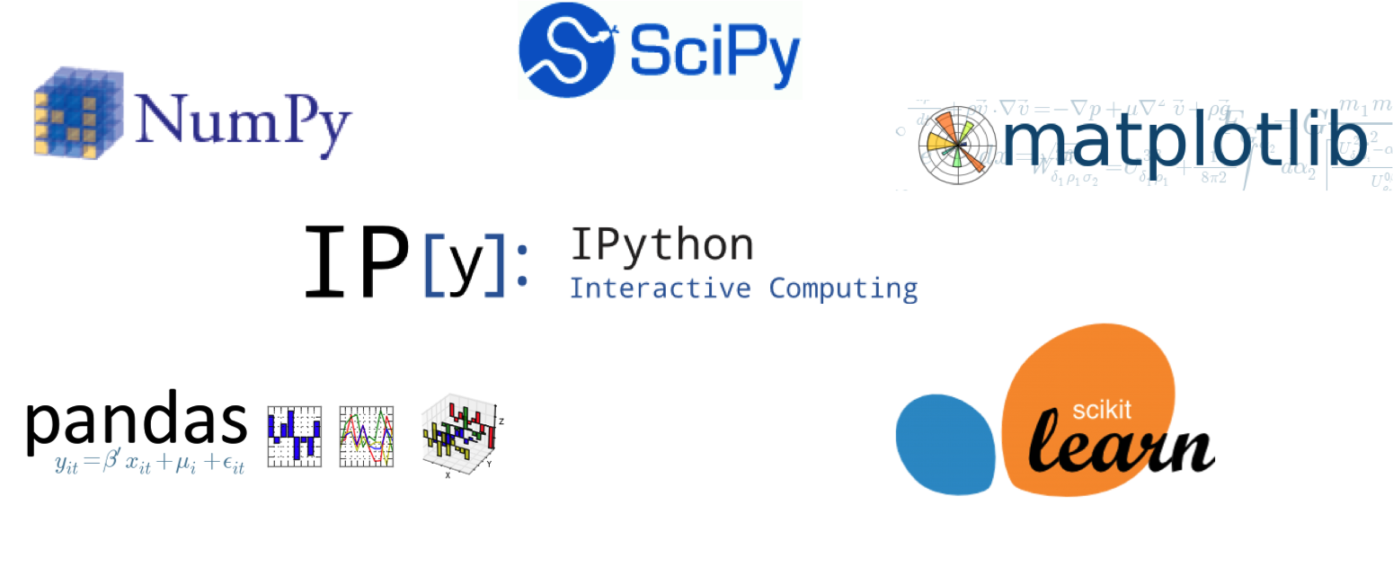
Tools and Tweaks
Internal
Anaconda Installation
conda create –n <env_name> python=3.5
activate <env_name>
conda install numpy scikit-learn matplotlib pandas jupyter notebook
Jupyter Notebook
Some Useful Libraries: NumPy, pandas, matplotlib

Slide 4


What is Machine Learning ??
Internal
The field of study that gives computers the ability to learn without being explicitly programmed - Arthur Samuel
A computer program is said to learn from experience E with respect to some class of tasks T and performance measure P, if its performance at tasks in T, as measured by P, improves with experience E. - Tom Mitchell
Example: playing checkers.
E = the experience of playing many games of checkers
T = the task of playing checkers.
P = the probability that the program will win the next game.

Slide 5

Types in ML
Internal
Machine Learning
Supervised learning
Unsupervised Learning
Association
Clustering
Regression
Classification
Reinforcement learning

Slide 6
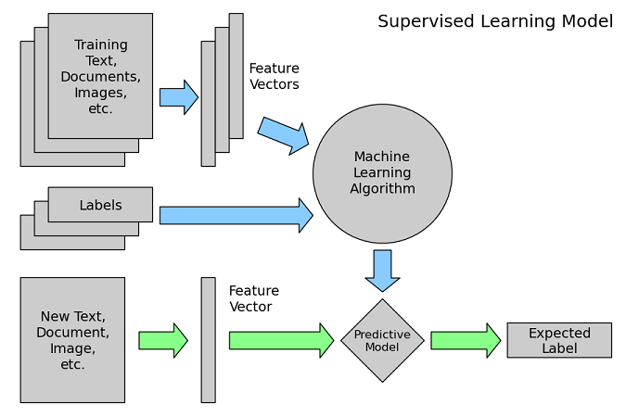
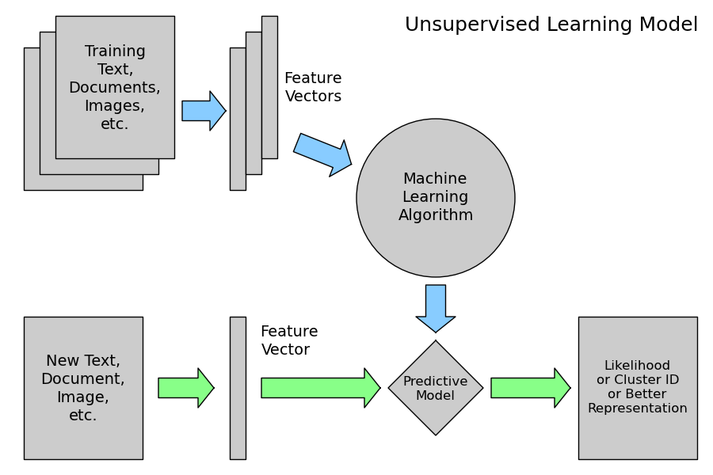
Supervised and Unsupervised Learning

Slide 7
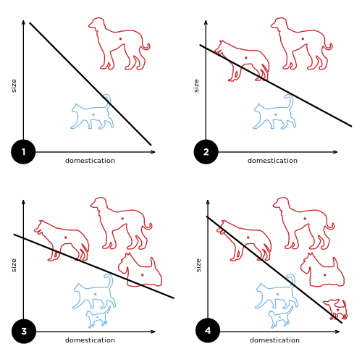
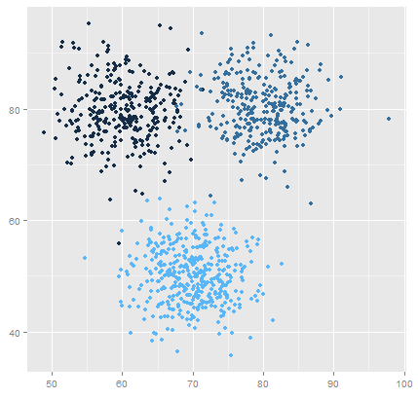
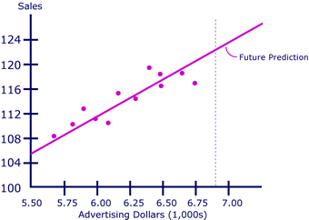
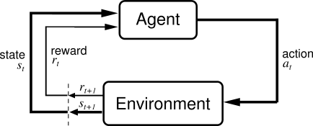
Examples
Regression
Classification
Clustering
Reinforcement Learning
Notes:
Regression -> House prices prediction; Sales vs advertising dollars
Classification -> Based on the hours of study and projects will the student get an admission in college or not; To release the order or not; The end product is defective or not
Clustering -> News articles; Similar materials in BOM
Association -> If a person buys a product A he is willing to buy the product B; If the company is purchasing a materials then its associated materials will also be purchased
Reinforcement -> Games learning, self driving car

Slide 8
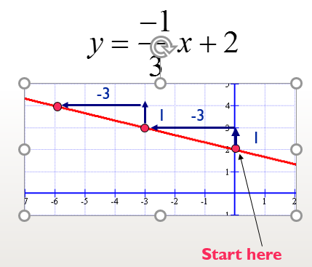
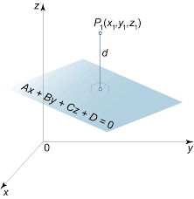
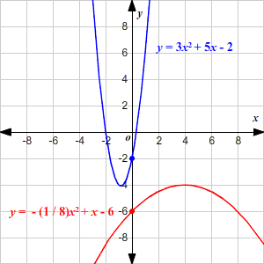
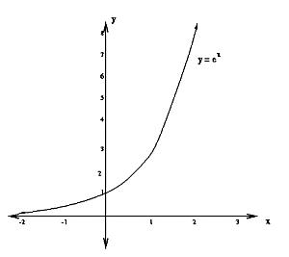
Basic Math

Slide 9
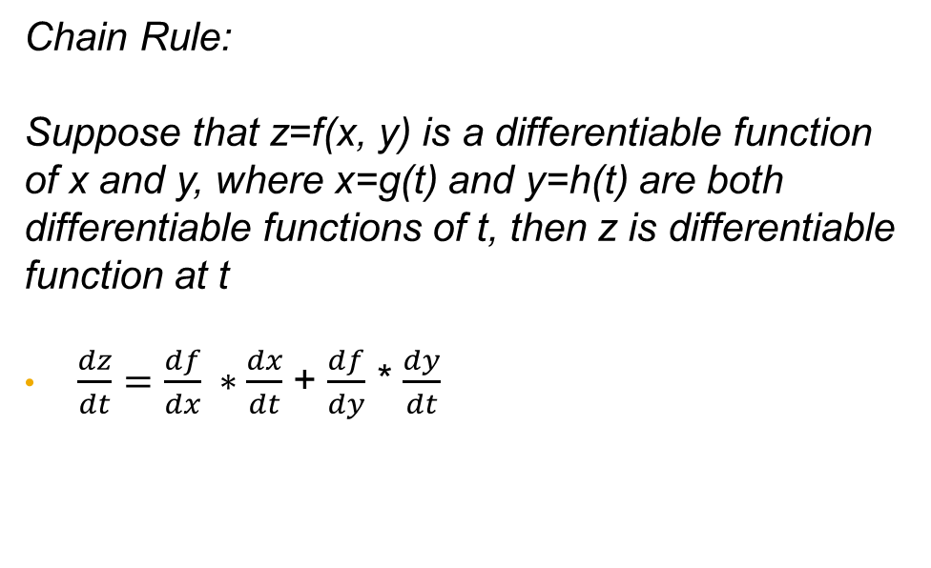
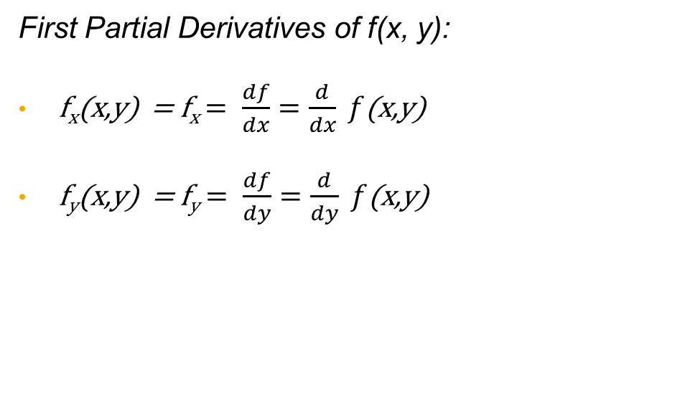
PARTIAL DERIVATIVES
Real valued function of two variables z = f ( x, y ), where z is independent variable and x and y are independent variables.
First Partial Derivatives of f(x, y):
f_{x}(x,y) = f_{x} $= \frac{df}{dx}=\frac{d}{dx} f$(x,y)
f_{y}(x,y) = f_{y} $= \frac{df}{dy}=\frac{d}{dy} f$(x,y)
Chain Rule:
Suppose that z=f(x, y) is a differentiable function of x and y, where x=g(t) and y=h(t) are both differentiable functions of t, then z is differentiable function at t
$\frac{dz}{dt}=\frac{df}{dx} ∗\frac{dx}{dt}$ + $\frac{df}{dy}$ * $\frac{dy}{dt}$

Slide 10
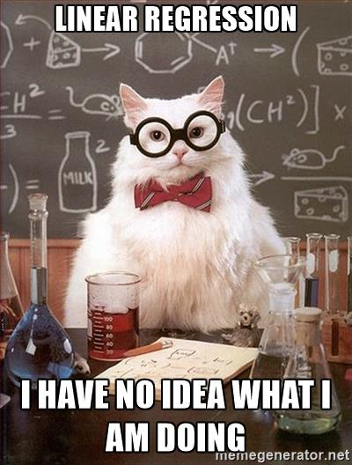
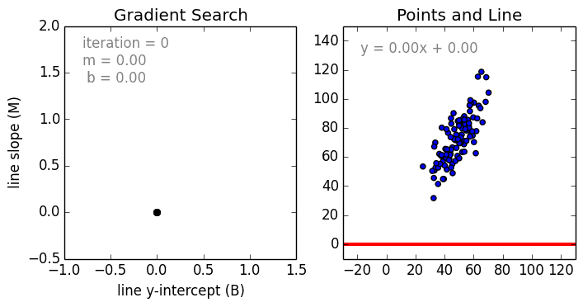
Regression
Internal
Notes:
1.) Take an example and construct the dataset x,y values
2.) Take a simple approach y = mx and plot the diagrams between m and j(m) and display where the value j(m) is less

Slide 11

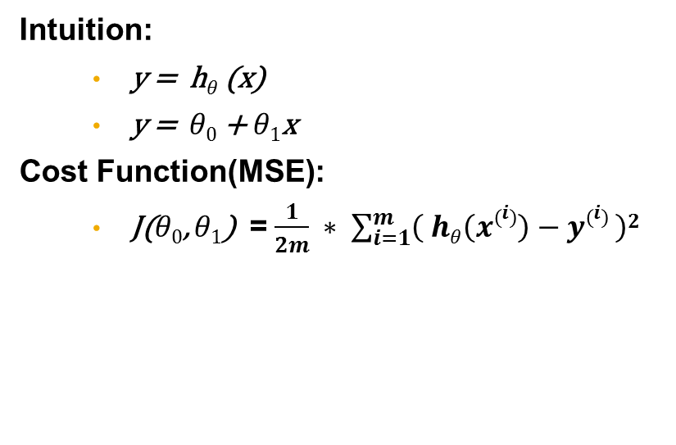
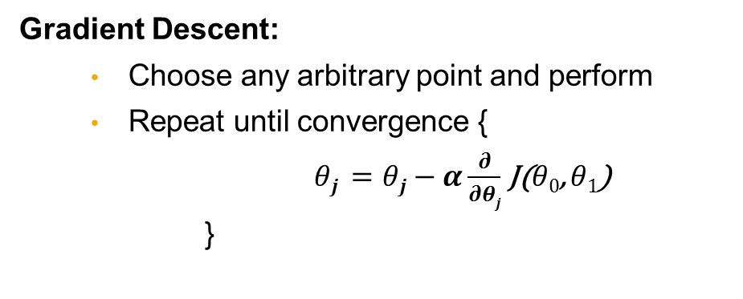
Math Behind Linear Regression
Intuition:
y = h$θ$(x)
y = $θ0$ + $θ1$x
Cost Function(MSE):
J($θ0$, $θ1$) = $\frac{1}{2m} ∗ \sum_{i=1}^{m}{\left( hθ\left(x\left(i\right)\right)−y\left(i\right) \right)2}$
Gradient Descent:
Choose any arbitrary point and perform
Repeat until convergence {
$θj =θj−α\frac{∂}{∂θj}$ J($θ0$, $θ1$)
}
Notes:
Steps:
1.) when a plot is represented between the theta and error, repeat the loop until the convergence
2.) derive the theta0, theta1

Slide 12
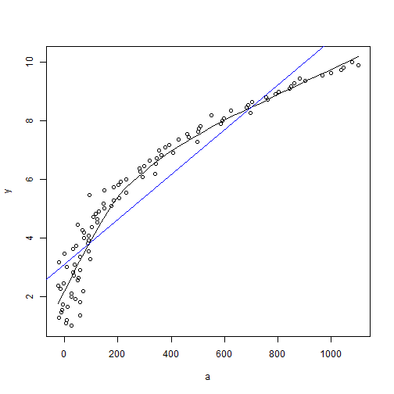

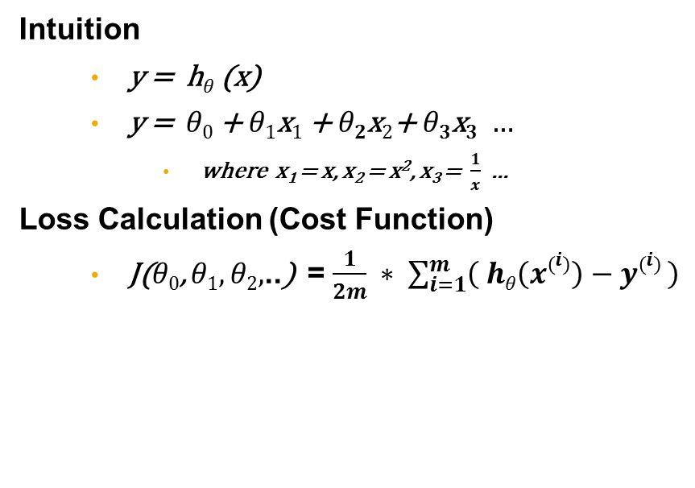
Polynomial Regression
Intuition
y = h$θ$(x)
y = $θ0$ + $θ1$x$1$ + $θ2$x$2\text{+ }θ3\text{x}3 …$
where x₁ = x, x₂ = x², x₃ = $\frac{1}{x}$ ...
Loss Calculation (Cost Function)
J($θ0$, $θ1,θ2,$..) = $\frac{1}{2m} ∗ \sum_{i=1}^{m}{\left( hθ\left(x\left(i\right)\right)−y\left(i\right) \right)}$
Gradient Descent:
Choose any arbitrary point and perform
Repeat until convergence {
$θj =θj−α\frac{∂}{∂θj}$ J($θ0$, $θ1,θ2,\text{..}$)
}

Slide 13
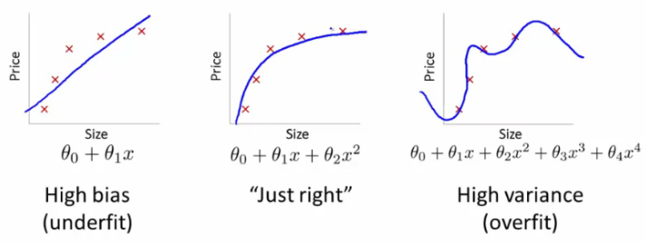
Bias Vs. Variance

Slide 14
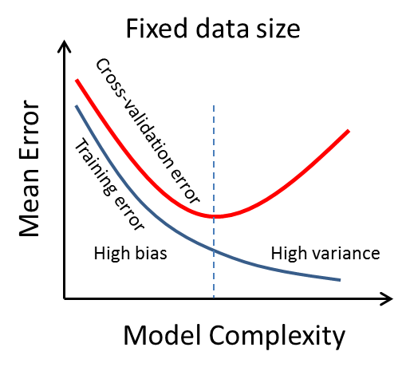
Bias Vs. Variance (Contd..)

Slide 15

Linear Regression Demo + HandsOn

Slide 16
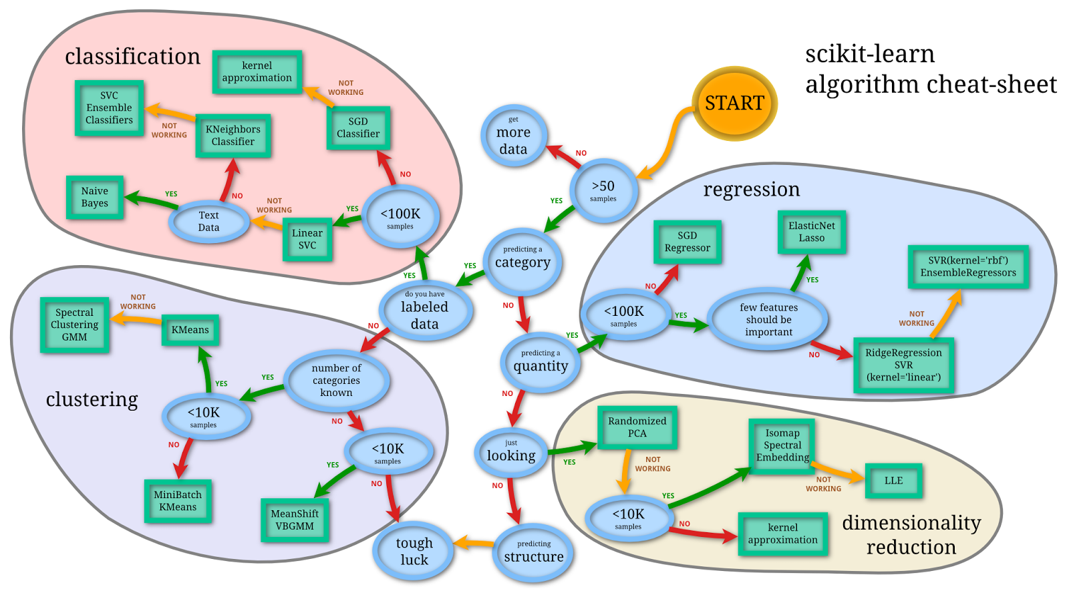
Scikit Learn
Machine Learning Library
Steps for Building a Model
model.fit(x_train, y_train)
model.predict(x_test)
model.score(x_test, y_test)

Slide 17
`sklearn` Demo + HandsOn

Slide 18
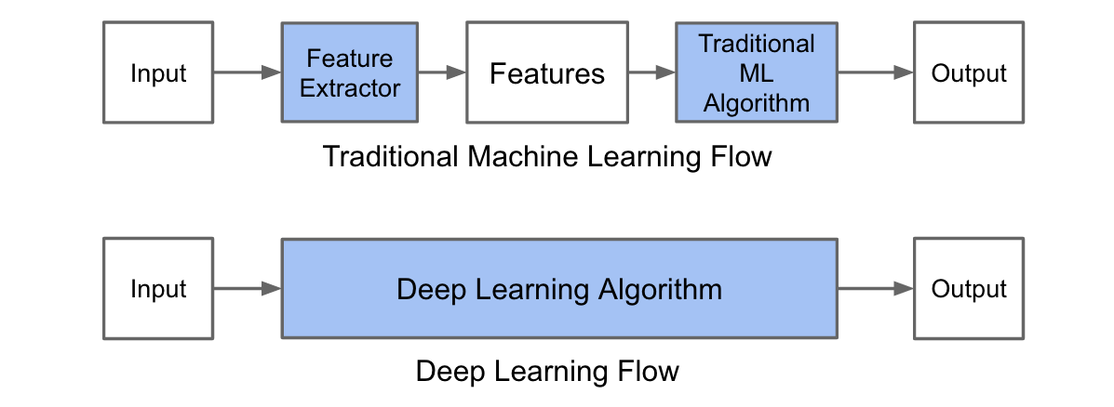
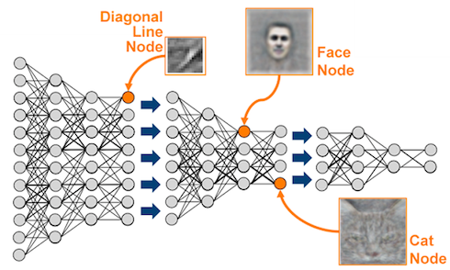
Machine Learning Vs. Deep Learning

Slide 19


Slide 20
Thank you
Contact information:
Sundeep Gullapudi
Developer/ Pentester
Ph: 8977061710

